Slide 1
Maximizing ARIA-CTR Performance through Kernel-Level Memory Optimization on the Apple M1 GPU
Si-Woo Eum, Min-Ho Song, Min-Joo Sim, Hwa-Jeong Seo*
Hansung University
Notes:
Hello, I'm Siwoo Eum, and I'll be presenting 'Maximizing ARIA-CTR Performance through Kernel-Level Memory Optimization on the Apple M1 GPU.' While there will be a Q&A session after the presentation, but honestly, my English isn't very good, so I might not be able to provide a thorough answer. Therefore, I've included my email address at the bottom of every slide. If you have any questions, please feel free to send them to email, and I'll be happy to provide detailed responses.

Slide 2
CONTENT
1. Introduction
2. Related Work (ARIA, CTR Mode, M1 GPU Architecture)
3. Implementation Strategies
4. Performance Results and Analysis
5. Conclusion
Notes:
The presentation will proceed in the following order.

Slide 3



1. Introduction
GPGPU(General Purpose Graphics Processing Unit)
Using GPUs for general-purpose computing beyond graphics
Early Period
1990-2000s
Innovation
2007
Current
GPUs were originally dedicated to graphics processing. Scientists repurposed graphics APU(OpenGL) to enable GPGPU.
NVIDIA's CUDA brought GPGPU into the mainstream. This enabled massively parallel processing leveraging thousands of cores.
GPUs have become essential for modern high-performance computing across AI, deep learning, scientific simulations, and cryptography.
Notes:
General Purpose Graphics Processing Unit—refers to technology that allows GPUs to be used beyond their original graphics processing purpose. Initially, GPUs were designed exclusively for graphics rendering, and developers could only use them for other tasks through various workarounds. The landscape changed dramatically when NVIDIA introduced CUDA, which made GPGPU accessible for a wide range of applications. Today, GPUs have become essential components in fields like AI and are now regarded as critical assets that reflect national competitiveness.

Slide 4
1. Introduction
While massively parallel processing became possible, memory access speed emerged as the critical bottleneck, rather than computational speed.
For discrete GPU(dGPU), the PCIe bus used for data transfer between CPU and GPU memory became the primary performance limitation.
Advent of System-on-Chip(SoC) and Unified Memory Architecture(UMA)
SoC designs like Apple M1 integrate the CPU, GPU, and memory onto a single chip.
UMA enables CPU and GPU to share the same memory pool, completely eliminating the data transfer bottleneck
Notes:
GPUs excel at parallel processing of large-scale data, but to fully leverage this advantage, efficient data management is crucial. In traditional discrete GPU systems, data must be copied from CPU to GPU for processing, which creates a significant bottleneck that requires optimization. Apple's M1 chip, introduced relatively recently, addresses this challenge through its Unified Memory Architecture, or UMA. By enabling the CPU and GPU to share the same memory pool, UMA eliminates the data copy bottleneck entirely

Slide 5
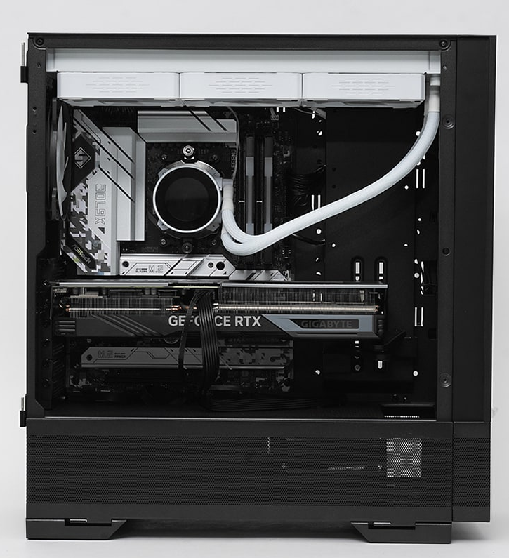
2. Related Work – SoC and dGPU
dGPU(Discrete GPU)
Separate graphics card with dedicated VRAM
Connected to CPU via PCIe bus
CPU↔GPU data copy required
dGPU systems require explicit data copying operations, such as cudaMemcpy, to transfer data between CPU and GPU memory.
CPU
GPU
Notes:
Let me provide a brief overview of dGPU and SoC architectures. Starting with discrete GPUs, they feature dedicated VRAM located on the graphics card itself. This VRAM communicates with the CPU's memory via the PCIe bus for data transfer. For instance, in CUDA programming, an explicit data copy step from CPU to GPU using cudaMemcpy is necessary before kernel execution. As you can observe in this picture that the CPU and GPU are physically distinct components.

Slide 6
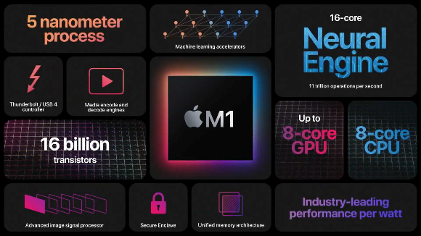
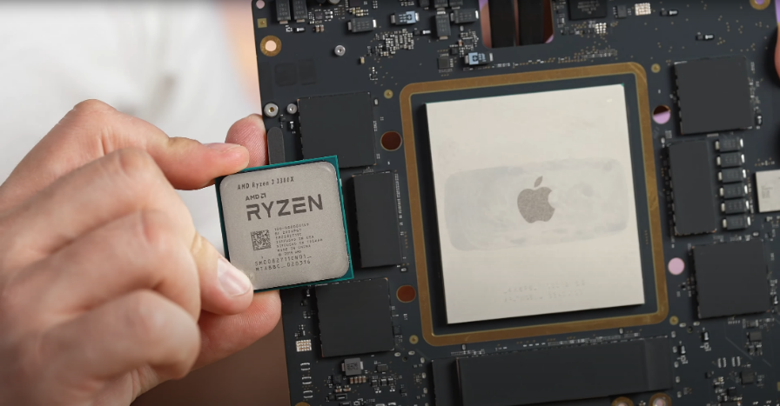
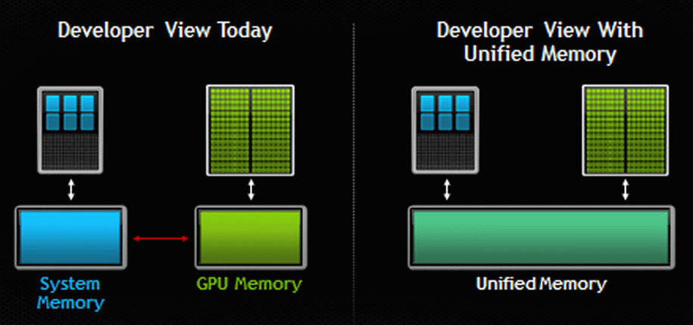
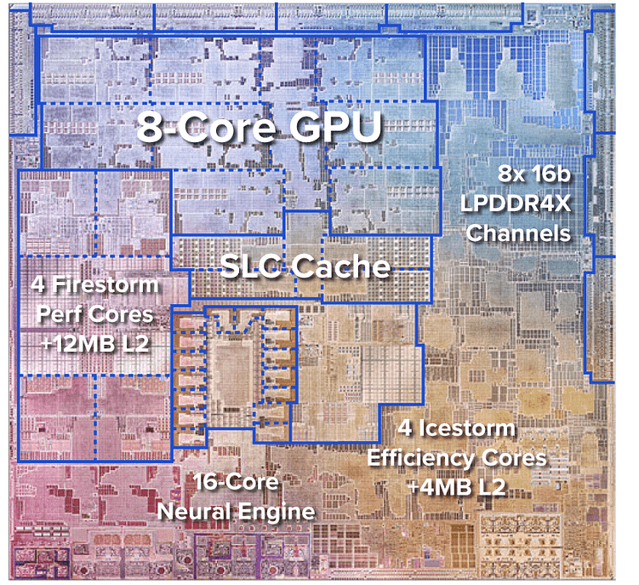
2. Related Work – SoC and dGPU
SoC(System-on-Chip)
CPU, GPU, and memory integrated on a single chip
Uses UMA (Unified Memory Architecture)
No data copy required
https://gigazine.net/gsc_news/en/20201202-apple-m1-fast/
Notes:
In contrast, SoC integrates the CPU and GPU onto a single chip. Looking at the actual of the M1 chip, you can see that it is even larger than the CPU in dGPU systems. Examining the internal architecture, we can observe an 8-core GPU and an (4+4)-core CPU, with channels connecting to RAM visible on the right side. Through these channels, the CPU and GPU utilize unified memory, eliminating the need for data copying processes unlike dGPUs.

Slide 7
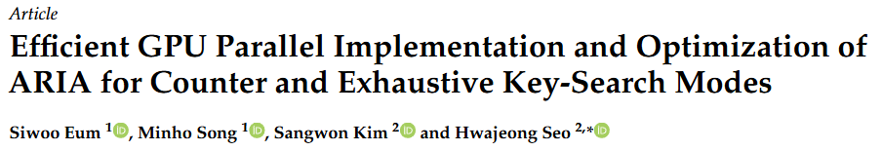
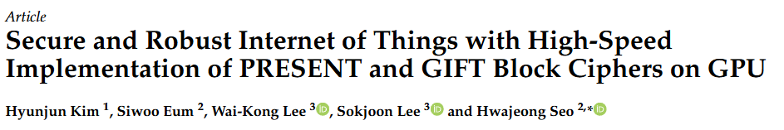
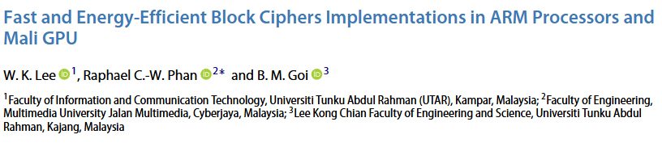
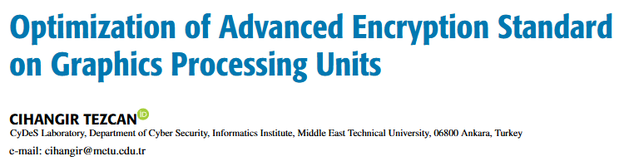
2. Related Work
Generally, research on block cipher optimization using dGPUs has been conducted in the direction of efficient memory utilization within dGPUs and minimizing bank conflicts.
Eum, Siwoo, et al. "Efficient GPU Parallel Implementation and Optimization of ARIA for Counter and Exhaustive Key-Search Modes." Electronics 14.10 (2025): 2021.
Kim, Hyunjun, et al. "Secure and robust Internet of Things with high-speed implementation of PRESENT and GIFT block ciphers on GPU." Applied Sciences 12.20 (2022): 10192.
Lee, Wai Kong, Raphael C-W. Phan, and Bok Min Goi. "Fast and energy-efficient block ciphers implementations in ARM processors and mali GPU." IETE Journal of Research 68.4 (2022): 2675-2682.
Tezcan, Cihangir. "Optimization of advanced encryption standard on graphics processing units." IEEE Access 9 (2021): 67315-67326.
Notes:
Most GPU-based cryptographic implementations rely on dGPUs, with numerous studies emphasizing efficient memory utilization strategies. As an extension of this research, this paper analyzes whether memory optimization techniques proven effective in dGPU environments can be equally applied to SoC GPUs.

Slide 8
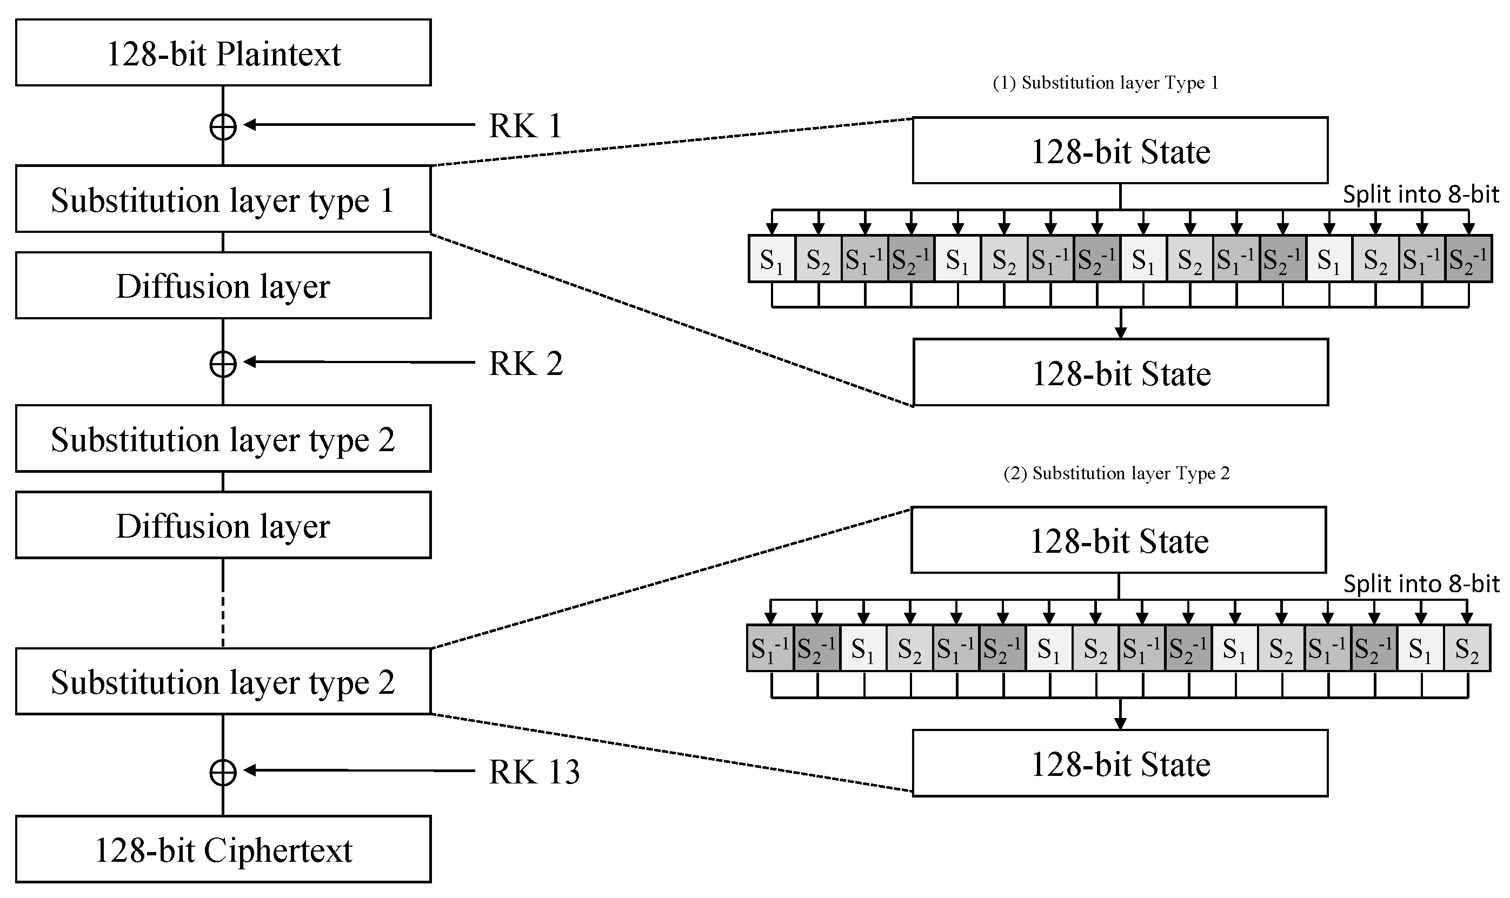
2. Related Work – ARIA Block Cipher
Target Block Cipher – ARIA
Korean standard block cipher used as a 128-bit block cipher
Based on SPN (Substitution Permutation Network) structure similar to AES
Core Operations
Round Key Addition
Substitution
Uses two types of S-box table
Diffusion
Notes:
This paper targets ARIA, one of Korea's standard block ciphers, as our cryptographic algorithm. We determined that SPN-structured block ciphers are well-suited for analyzing memory efficiency. For algorithms without hardware acceleration support—unlike AES—maximizing optimization through parallel processing capabilities such as GPU computing is essential. With this in mind, we analyzed the optimal memory placement for storing round keys and S-boxes

Slide 9
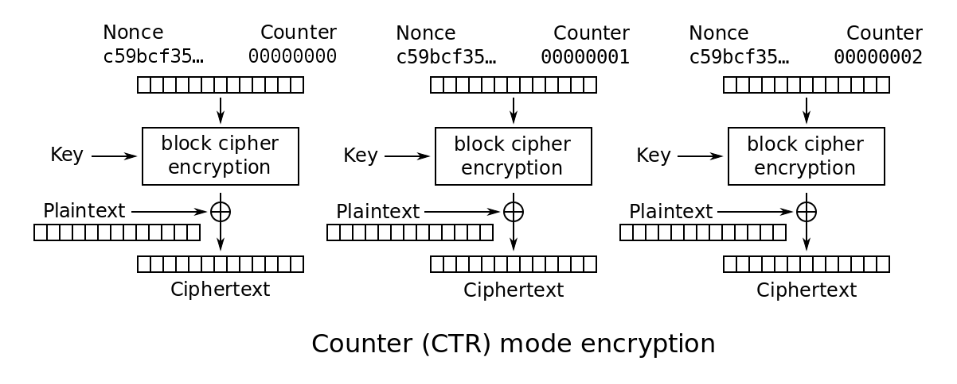
2. Related Work – Counter Mode
Counter Mode
An operation mode that uses block ciphers like stream ciphers
Unlike other operation modes, each block can be computed independently, enabling parallel processing
Notes:
We chose to implement Counter mode over ECB mode, as Counter mode is a fundamental component of GCM (Galois/Counter Mode), which is extensively used in modern cryptographic applications.

Slide 10
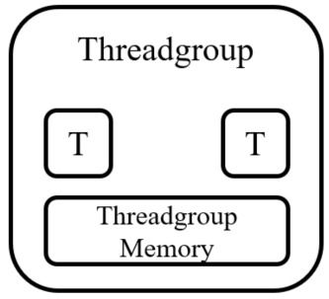
2. Related Work – Memory models of Metal
Device memory
Main memory accessible by GPU kernels. In UMA environments, this corresponds to system RAM. Offers the largest capacity but has the longest access latency.
Threadgroup memory
High-speed on-chip memory shared among all threads within a threadgroup. Requires explicit programmer management but provides extremely low latency, making it ideal for caching frequently accessed data.
Constant memory
Specialized memory space for read-only data that remains unchanged during kernel execution. Features dedicated cache access and hardware broadcast optimization when all threads simultaneously read from the same address.
GPU
Threadgroup
T
. . .
T
. . .
Threadgroup Memory
CPU
Constant Memory
UMA
Device Memory
Notes:
Metal is a low-level API that allows direct control of GPUs on Apple devices. Similar to CUDA, it supports various memory models, with the most notable being device, threadgroup, and constant memory.
Device memory serves as the main memory accessible by GPU kernels. In UMA environments, this corresponds to system RAM. While it offers the largest capacity, it also has the longest access latency.
Threadgroup memory is high-speed on-chip memory shared among all threads within a threadgroup. Although it requires explicit programmer management, it provides extremely low latency, making it ideal for caching frequently accessed data.
Constant memory is a specialized memory space designed for read-only data that remains unchanged during kernel execution. It features dedicated cache access and hardware broadcast optimization, which is particularly effective when all threads simultaneously read from the same address

Slide 11
3. Implementation Strategies
Research Hypothesis
Even in UMA environments, performance can be significantly improved by utilizing optimal memory hierarchies (threadgroup, constant) that match data access patterns, compared to using only device memory.
Notes:
Our hypothesis is that, like dGPUs, SoC GPUs also require memory optimization for performance enhancement, and that optimization strategies from dGPU research are equally applicable

Slide 12
3. Implementation Strategies
Memory-Stored Data Structures with Distinct Access Patterns
S-Box Table
Access Pattern: Non-uniform (irregular)
Characteristics: Data-dependent memory accesses where each thread references distinct addresses
Round Key
Access Pattern: Uniform (broadcast)
Characteristics: Synchronized access where all threads reference identical memory locations simultaneously
T
T
T
T
T
T
T
T
M
M
M
M
M
M
M
M
T
T
T
T
T
T
T
T
M
Notes:
The memory access patterns play a critical role in determining the optimal memory placement for S-box tables and round keys. For S-boxes, the access pattern is irregular and data-dependent—each thread may access different locations based on the data being processed. Round keys, on the other hand, exhibit a uniform access pattern where all threads simultaneously access the same memory location to retrieve identical round key values.

Slide 13
3. Implementation Strategies
Six Memory Placement Strategies
Type | S-box | Round Keys
Type 1 (Baseline) | device | device
Type 2 | threadgroup | device
Type 3 | constant | device
Type 4 | threadgroup | threadgroup
Type 5 | threadgroup | constant
Type 6 | device | constant
Notes:
To analyze in detail which memory configurations provide the most efficient performance with these characteristics, we implemented and compared six different memory placement strategies, as shown in this table. Type 1, which stores all data in device memory, was used as our baseline for performance comparison

Slide 14
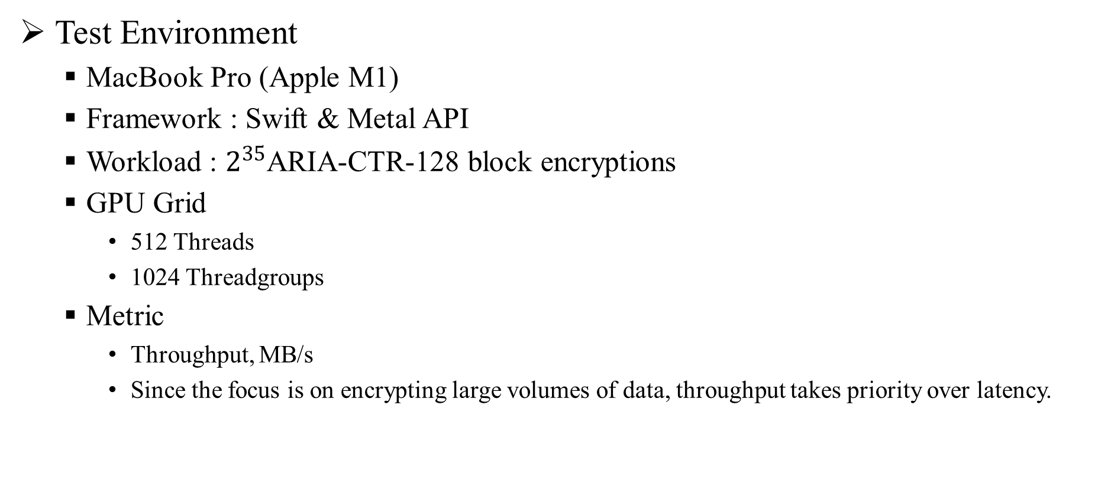
4. Performance Results and Analysis
Test Environment
MacBook Pro (Apple M1)
Framework : Swift & Metal API
Workload : $2^{35}$ARIA-CTR-128 block encryptions
GPU Grid
512 Threads
1024 Threadgroups
Metric
Throughput, MB/s
Since the focus is on encrypting large volumes of data, throughput takes priority over latency.
Notes:
Let me present our test environment.
We used a MacBook Pro with Apple M1, implementing our solution in Swift and Metal API. The workload consisted of 2^35 ARIA-CTR-128 block encryptions.
For GPU configuration, we deployed 512 threads per threadgroup across 1024 threadgroups.
Our key metric is throughput in megabytes per second. Given our focus on large-scale data encryption, throughput takes priority over latency.

Slide 15
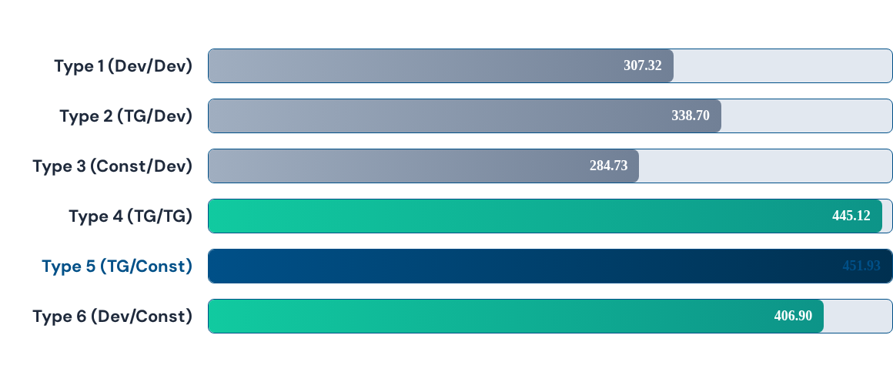
4. Performance Results and Analysis
Performance Results
Type n (S-box/Round key)
Notes:
Here are our performance results across six configurations.
Type 1, our baseline with everything in device memory, achieved 307 megabytes per second.
Moving S-boxes to threadgroup memory in Type 2 improved performance to 339 megabytes per second.
Type 3, using constant memory for S-boxes, unexpectedly showed the lowest performance at 285 megabytes per second.
Type 4 and Type 5, both utilizing threadgroup memory for S-boxes, performed best. Type 5, which additionally places round keys in constant memory, achieved our highest throughput at 452 megabytes per second—a 47% improvement over baseline.
Type 6 demonstrates that even optimizing only round key placement provides substantial gains, reaching 407 megabytes per second.
…

Slide 16
4. Performance Results and Analysis
Best Performance – Type 5
S-box : Threadgroup / RK : Constant
451.93 MB/s (+47.07% (vs. Type 1))
This configuration optimally matches data access patterns: irregular S-box accesses leverage threadgroup memory's low latency, while uniform round key accesses exploit constant memory's broadcast optimization.
Worst Performance – Type 3
S-box : Constant / RK : Device
284.73 MB/s (-7.3% (vs. Type 1))
Irregular S-box access patterns led to decreased memory access efficiency, inducing a performance bottleneck that yielded lower throughput than the device memory baseline
Notes:
Type 5 delivered the best performance at 452 megabytes per second—a 47% improvement over baseline. This success comes from optimally matching memory to access patterns: threadgroup memory handles irregular S-box accesses, while constant memory exploits broadcast optimization for uniform round key accesses.
Conversely, Type 3 performed worst at 285 megabytes per second, even 7% below baseline. The mismatch between irregular S-box access patterns and constant memory created a bottleneck worse than using device memory.
This clearly demonstrates that aligning memory choice with access patterns is critical for performance.

Slide 17
4. Performance Results and Analysis
Impact of S-box Memory Placement
Device vs Threadgroup
Type 1 (Dev/Dev) : 307.32 MB/s
Type 2 (TG/Dev) : 338.70 MB/s ( +10.2%)
Simply relocating S-box to threadgroup memory yields a substantial 10.2% performance improvement.
This demonstrates that optimizing memory hierarchy for irregular access patterns remains critical even in UMA environments
Threadgroup vs Constant
Type 1 (Dev/Dev) : 307.32 MB/s
Type 3 (Const/Dev) : 284.73 MB/s (-7.3%)
This illustrates the pitfall of memory misalignment: constant cache, optimized for uniform accesses, suffers from continuous cache misses with irregular S-box lookups, yielding worse performance than device memory.
Notes:
Let's analyze the impact of S-box memory placement．
First, comparing device versus threadgroup memory: Type 1 with device memory achieved 307.32 megabytes per second, while Type 2 with threadgroup memory reached 338.70 megabytes per second—a 10.2% improvement. Simply relocating S-boxes to threadgroup memory yields a substantial performance gain. This demonstrates that optimizing memory hierarchy for irregular access patterns remains critical even in UMA environments.
Next, comparing threadgroup versus constant memory: Type 1 achieved 307.32 megabytes per second, while Type 3 with constant memory only reached 284.73 megabytes per second—a 7.3% decrease. This illustrates the pitfall of memory misalignment: constant cache, optimized for uniform accesses, suffers from continuous cache misses with irregular S-box lookups, yielding worse performance than device memory.

Slide 18
4. Performance Results and Analysis
Impact of Round Key Memory Placement (regular Access)
Device vs Constant
Type 1 (Dev/Dev) : 307.32 MB/s
Type 6 (Dev/Const) : 406.90 MB/s ( +32.4%)
Moving Round Key to constant memory produced even more dramatic performance gains than S-box optimization.
This suggests that M1's constant memory provides highly efficient hardware broadcast optimization.
Threadgroup vs Constant
Type 4 (Dev / TG) : 445.12 MB/s
Type 5 (Dev / Const) : 451.93 MB/s (+1.5%)
Both strategies are effective, though constant memory achieves slightly higher performance than threadgroup (1.5% improvement). This demonstrates the efficiency of hardware cache optimization for uniform access patterns.
Notes:
Next, the impact of round key memory placement.
Comparing device versus constant memory: Type 1 achieved 307.32 megabytes per second, while Type 6 with constant memory reached 406.90 megabytes per second—a 32.4% improvement. Moving round keys to constant memory produced even more dramatic performance gains than S-box optimization. This suggests that M1's constant memory provides highly efficient hardware broadcast optimization.
Comparing threadgroup versus constant memory for round keys: Type 4 with threadgroup memory achieved 445.12 megabytes per second, while Type 5 with constant memory reached 451.93 megabytes per second—a 1.5% improvement. Both strategies are effective, though constant memory achieves slightly higher performance than threadgroup. This demonstrates the efficiency of hardware cache optimization for uniform access patterns.

Slide 19
5. Conclusion - Limitations
The scope of this research was limited to evaluating performance impacts of various memory locations for S-box and Round Key storage.
Workload Configuration: Threadgroup size was fixed at 512 threads. The impact of varying this parameter (e.g., 256, 1024) on GPU occupancy was not explored.
Notes:
Before concluding, I should acknowledge the limitations of this research.
The scope of this research was limited to evaluating performance impacts of various memory locations for S-box and round key storage. We focused specifically on these two critical data structures.
Regarding workload configuration, the threadgroup size was fixed at 512 threads. The impact of varying this parameter—for example, using 256 or 1024 threads—on GPU occupancy was not explored. This represents an area for future investigation

Slide 20
5. Conclusion
Hypothesis Validation: We confirmed that access-pattern-optimized memory strategies critically impact performance even in UMA environments.
Optimal Strategy: A hybrid configuration—placing irregular S-box accesses in threadgroup memory and uniform Round Key broadcasts in constant memory—achieves optimal performance.
Future research will pursue two directions:
(1) dynamic optimization of GPU execution parameters to maximize occupancy.
(2) adaptation of established dGPU optimization strategies, particularly bank conflict minimization techniques, to the UMA context.
Notes:
In conclusion, we validated that memory optimization strategies remain critical even in UMA environments. Our optimal hybrid configuration—threadgroup memory for S-boxes and constant memory for round keys—achieved 47% performance improvement.
Future work will focus on two areas: optimizing GPU execution parameters for better occupancy, and adapting dGPU techniques like bank conflict minimization to UMA environments.

Slide 21
Thank you for listening to my presentation
shuraatum@gmail.com
Notes:
Thank you for your attention.

